Slide 1
Result Management System

Slide 2
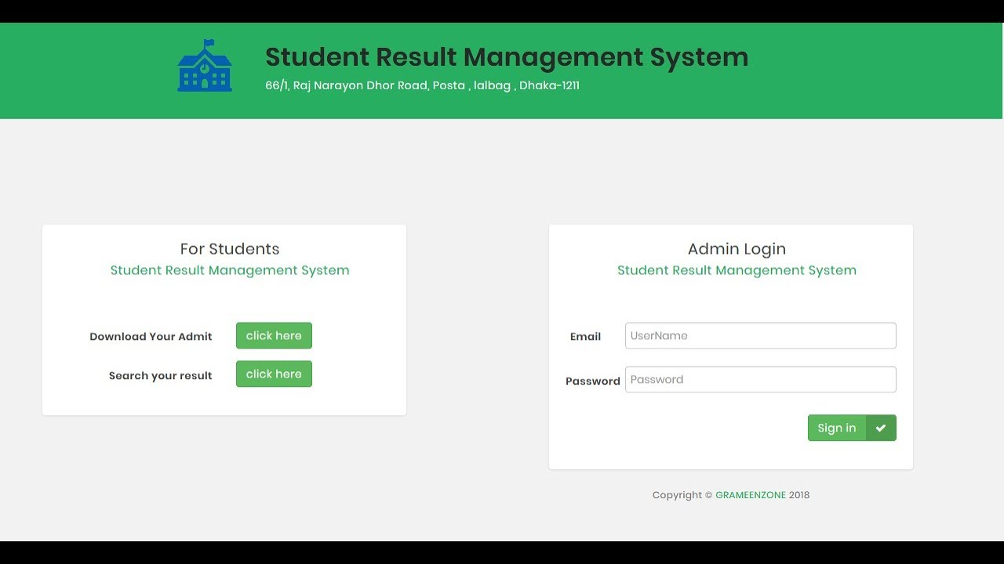
FrontEnd

Slide 3
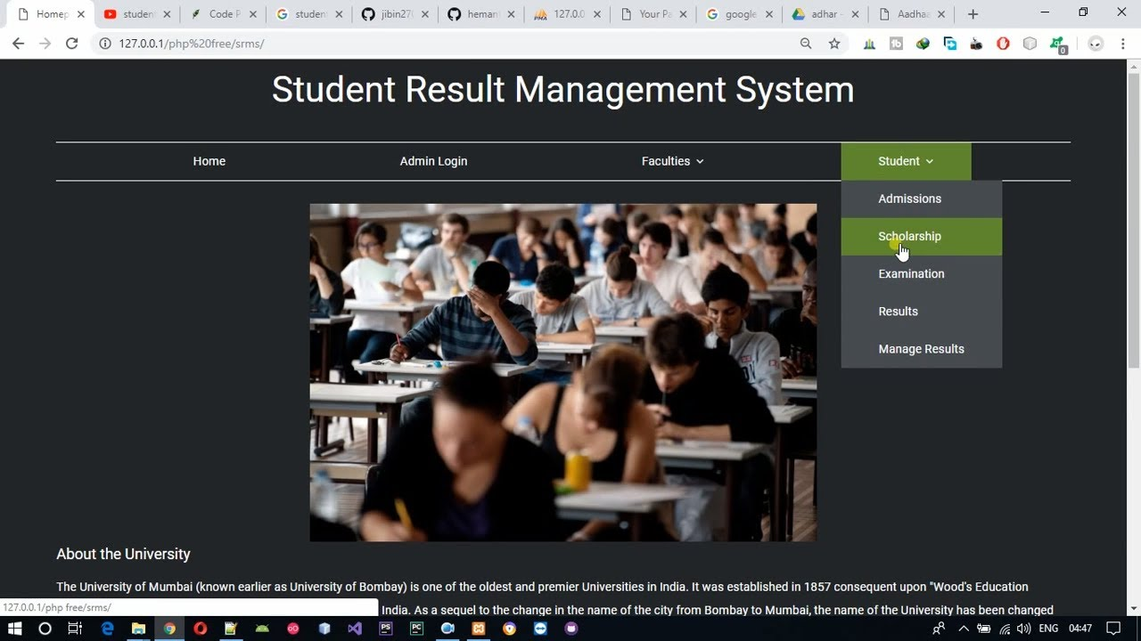
FrontEnd

Slide 4
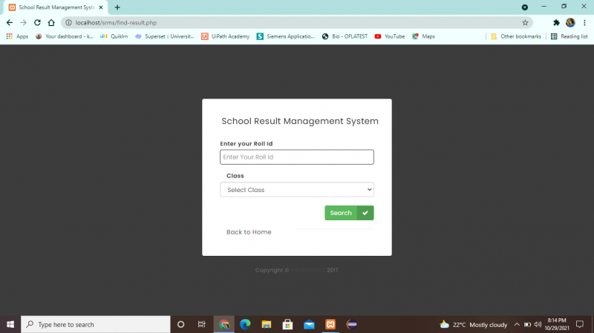
FrontEnd

Slide 5

FrontEnd

Slide 6

FrontEnd

Slide 7
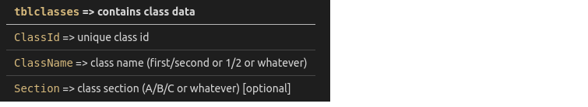
DataBase Handling

Slide 8
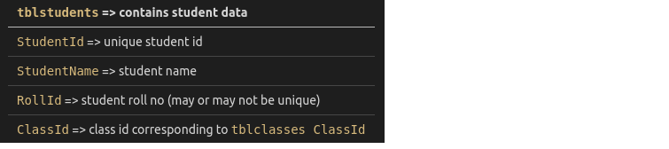
DataBase Handling

Slide 9
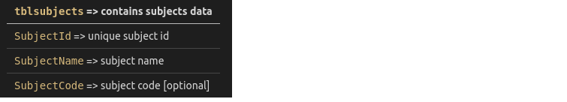
DataBase Handling

Slide 10
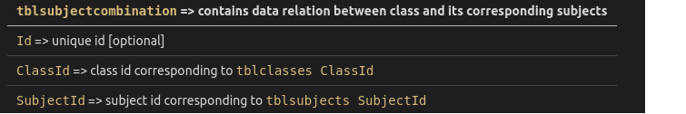
DataBase Handling

Slide 11
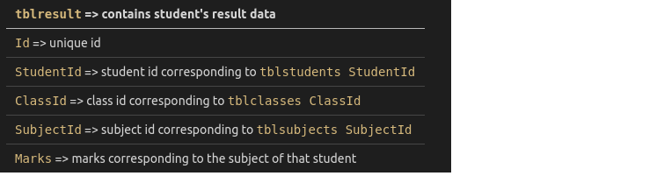
DataBase Handling

Slide 12
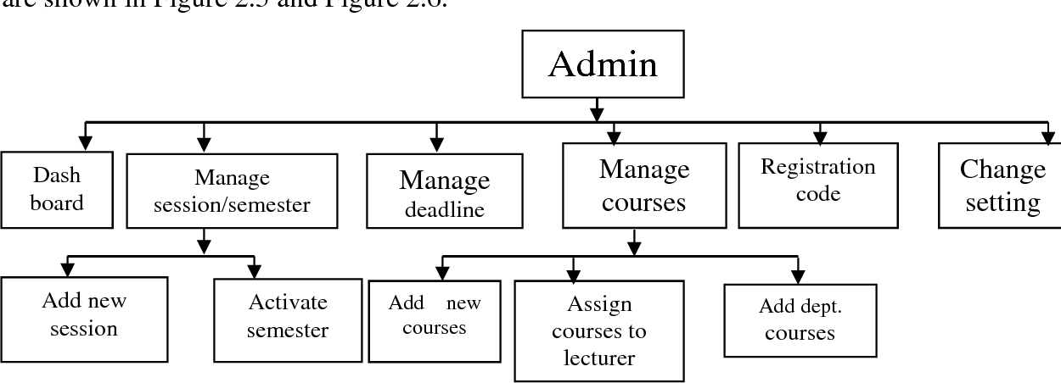
Admin(Backend)

Slide 13
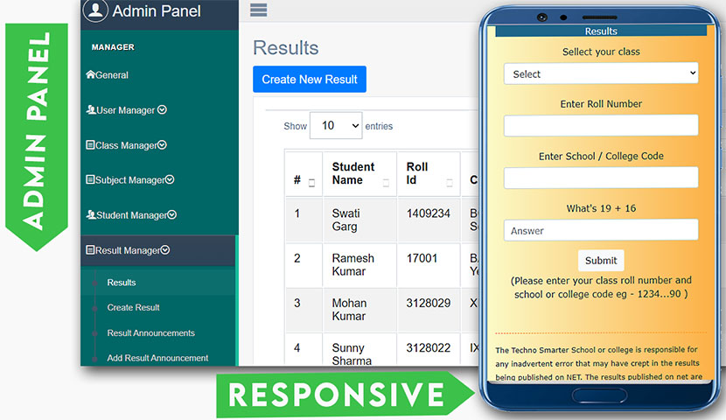
Admin(Backend)

Slide 14
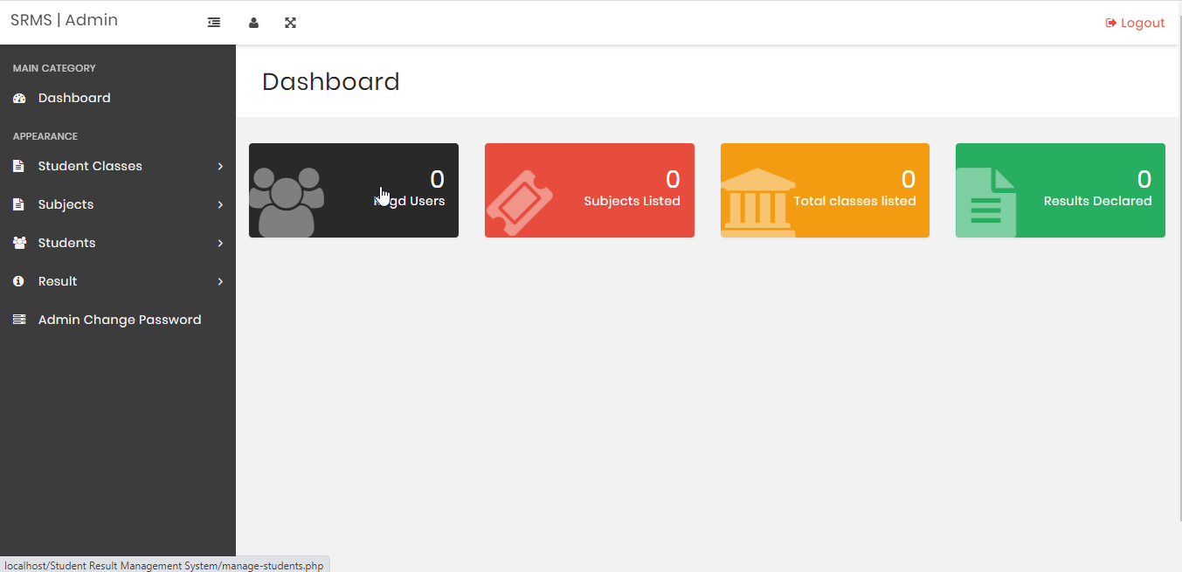
Admin(Backend)

Slide 15
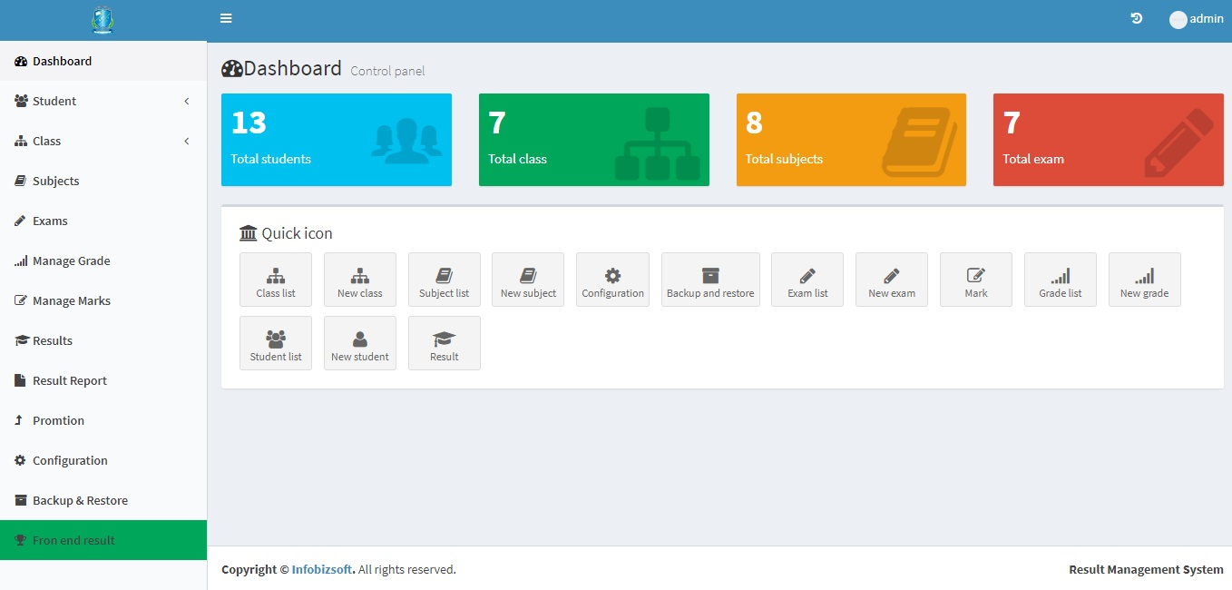
Admin(Backend)

Slide 16
Team?

